Slide 1
20240716_fv3000
M. LaPorta (IMPL-K)
Data from [scope] on [date]

Slide 2
Info:
SYTOX GREEN
Notes:
Slide ID: M3LP0132

Slide 3
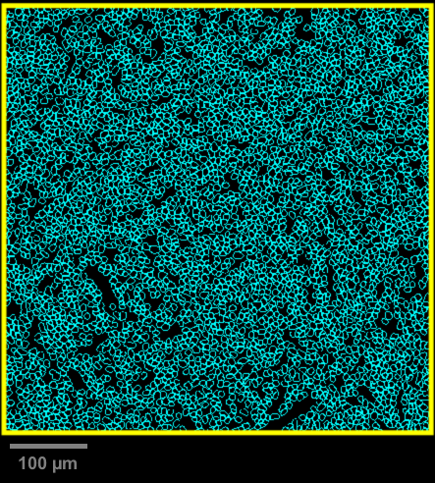
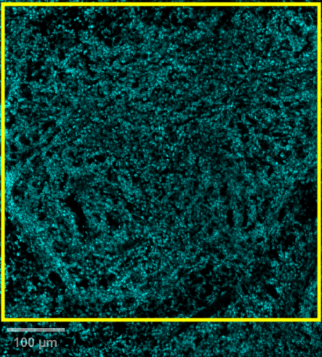
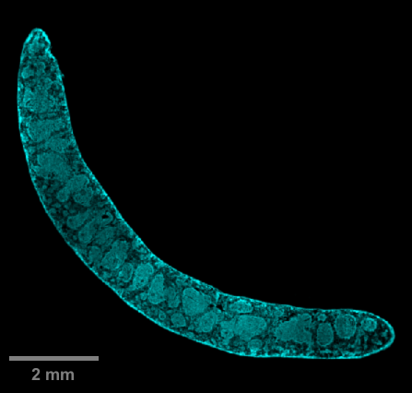
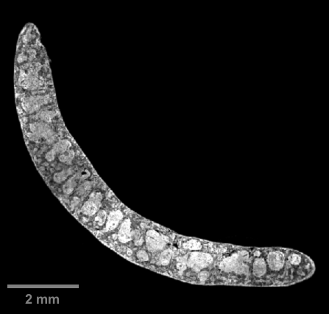
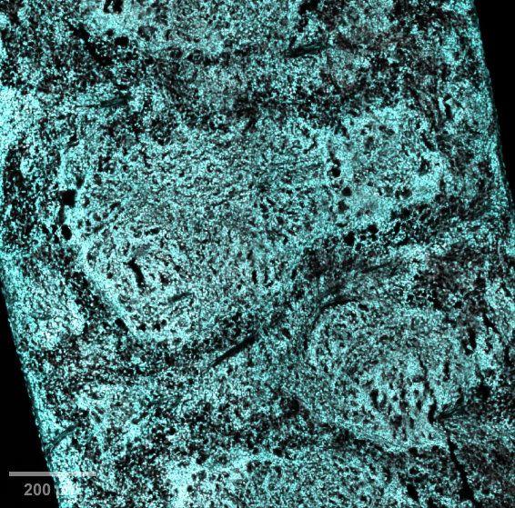
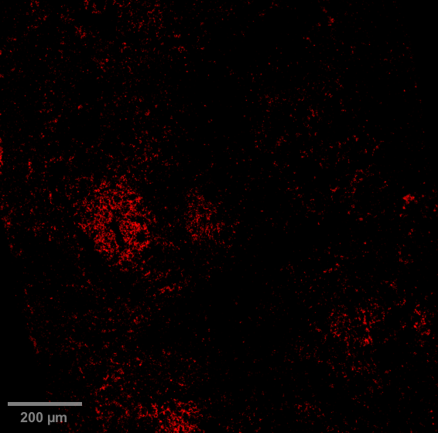
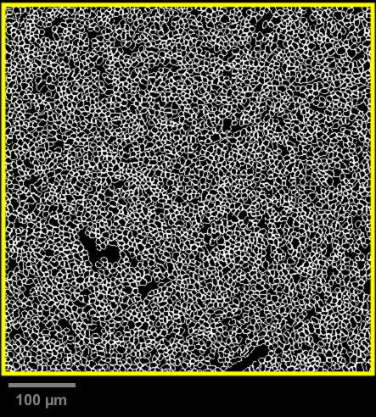
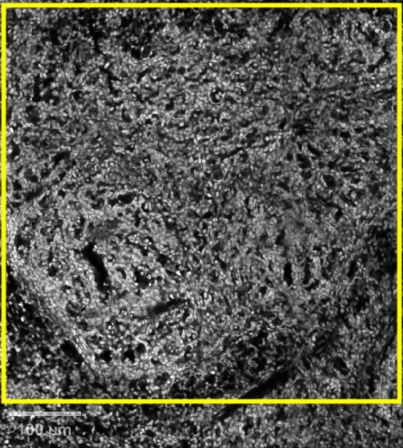
DAPI SYTOX GREEN B220
Slide ID: M3LP0457
x4, x20 objective
Mouse ID: 103 M1
Panel:
DAPI
SYTOX GREEN
B220 – AF700
DAPI – 4,079 nucleated cells detected; density (cells/mm²) = 126,417
QuPath segmentation
DAPI
Spleen – Naïve/healthy
DAPI
SYTOX GREEN
Signal in AF700
SYTOX GREEN – 4,108 nucleated cells detected; density (cells/mm²) = 127,316
DAPI SYTOX GREEN
ROI 1
B220
ROI 1
QuPath segmentation
SYTOX GREEN
SYTOX GREEN
Notes:
Yellow circle area (µm²) = 32266

Slide 4
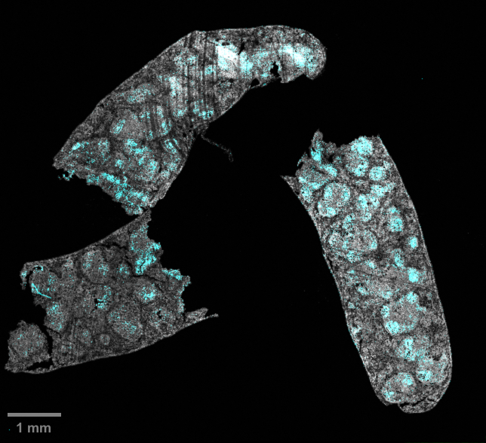
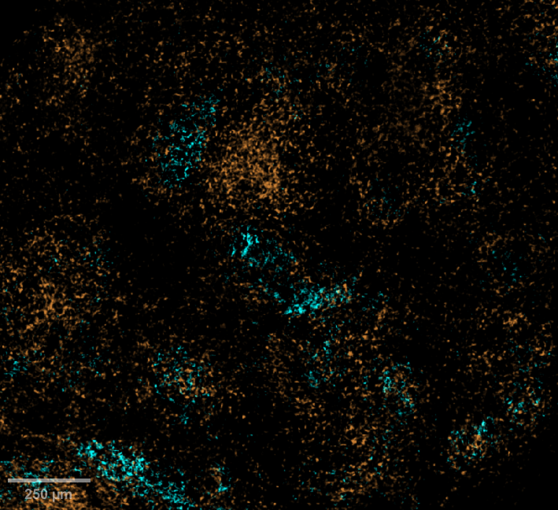
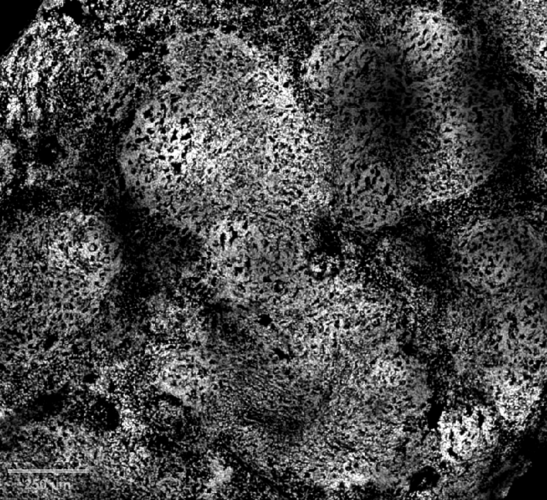
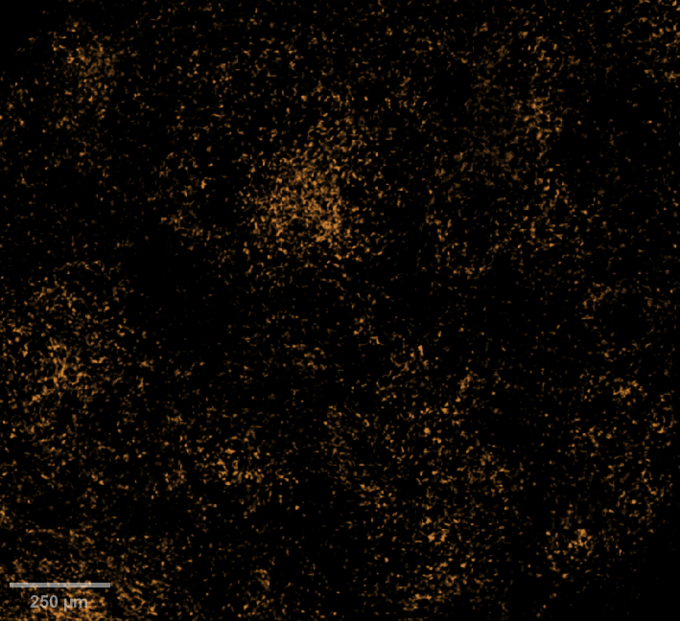
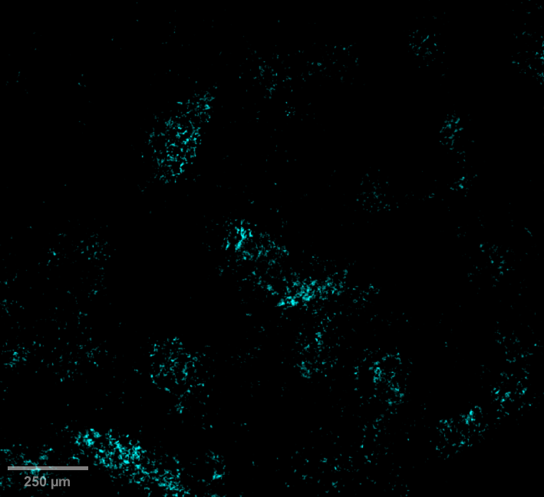
Slide ID: M3LP0458
Mouse ID: 103 M1
Panel:
B220 – BV421
SYTOX GREEN
CD3ε – eF660
Spleen – Naïve/healthy [x4 objective]
Spleen – Naïve/healthy [x20 objective]
B220 SYTOX GREEN
B220 CD3ε
SYTOX GREEN
CD3ε
B220
Notes:
New CD3ε antibody in eF660 (clone: 17A2; host = Rat IgG2b, κ; cat no.50-0032-82)

Slide 5
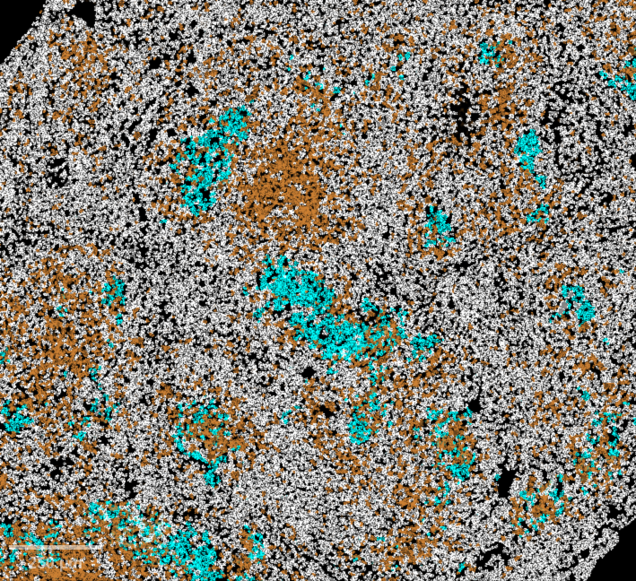
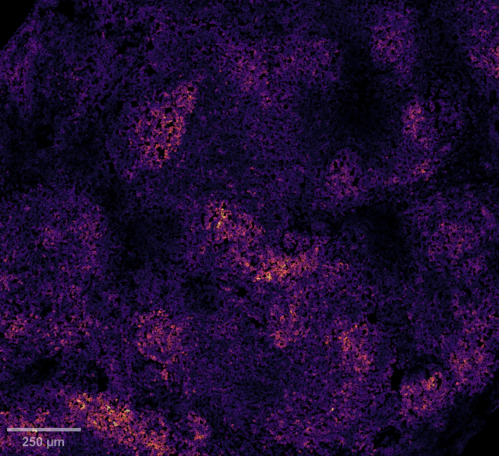
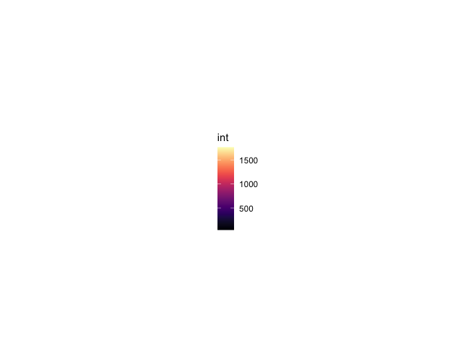
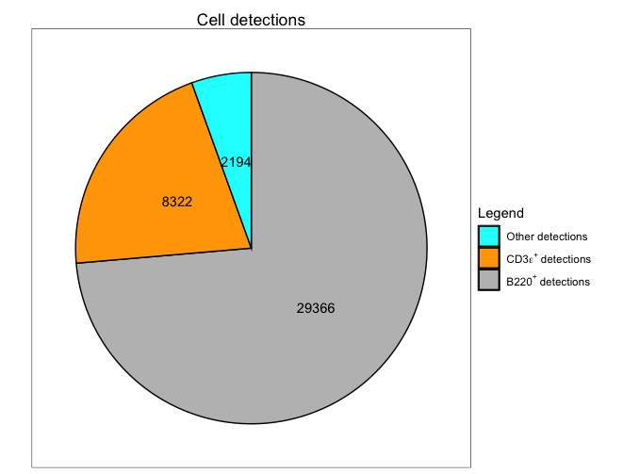
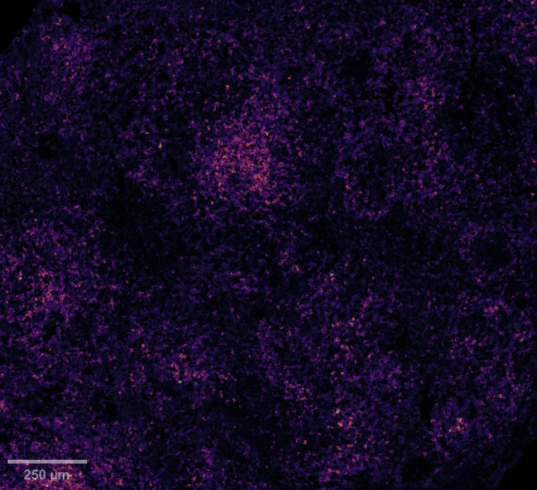
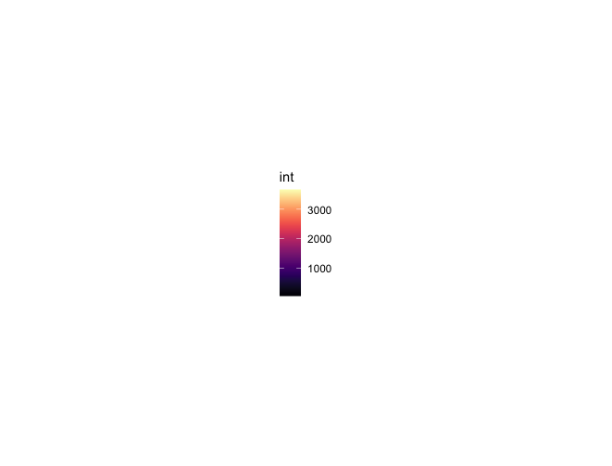
B220 SYTOX GREEN CD3ε
Slide ID: M3LP0458
x20 objective
Mouse ID: 103 M1
Panel:
B220 – BV421
SYTOX GREEN
CD3ε – eF660
QuPath composite object classifiers (~1hr)
Spleen – Naïve/healthy
B220 – 2194 B220⁺ B cells detected; density (cells/mm²) = 619
B220 CD3ε
QuPath segmentation
B220
B220 mean expression
CD3ε – 8,322 CD3ε⁺ T cells detected; density (cells/mm²) = 2,350
CD3ε
CD3ε mean expression
Notes:
Area (µm²) = 3,540,307
39,882 cells detected total from SYTOX GREEN stain

Slide 6
Info:
AD Panel 1
Notes:
Slide ID: M3LP0132

Slide 7
DCX NeuN BST2 Iba1
Slide ID: M3LP0455
x60 objective
Mouse ID: 103 M1
scale bar 50µm
FITC left open
Panel:
DCX – AF488
NeuN – AF555
BST2 – AF647
Iba1 – AF750
Brain – Naïve/healthy
Notes:
[…]

Slide 8
DCX NeuN BST2 Iba1
Slide ID: M3LP0455
x60 objective
Mouse ID: 103 M1
scale bar 50µm
FITC left open
Panel:
DCX – AF488
NeuN – AF555
BST2 – AF647
Iba1 – AF750
Brain – Naïve/healthy
Notes:
[…]

Slide 9
Info:
Liver + CD4
Notes:
Slide ID: M3LP0132

Slide 10
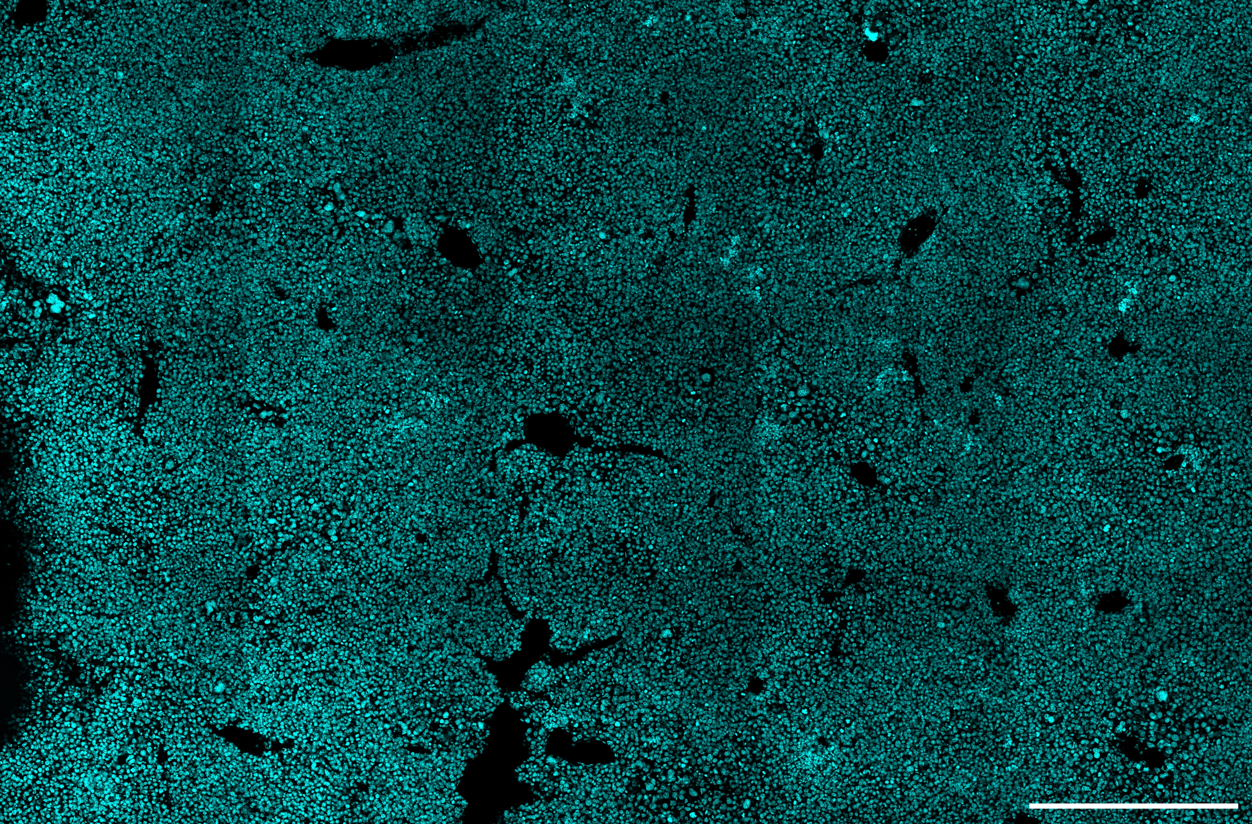
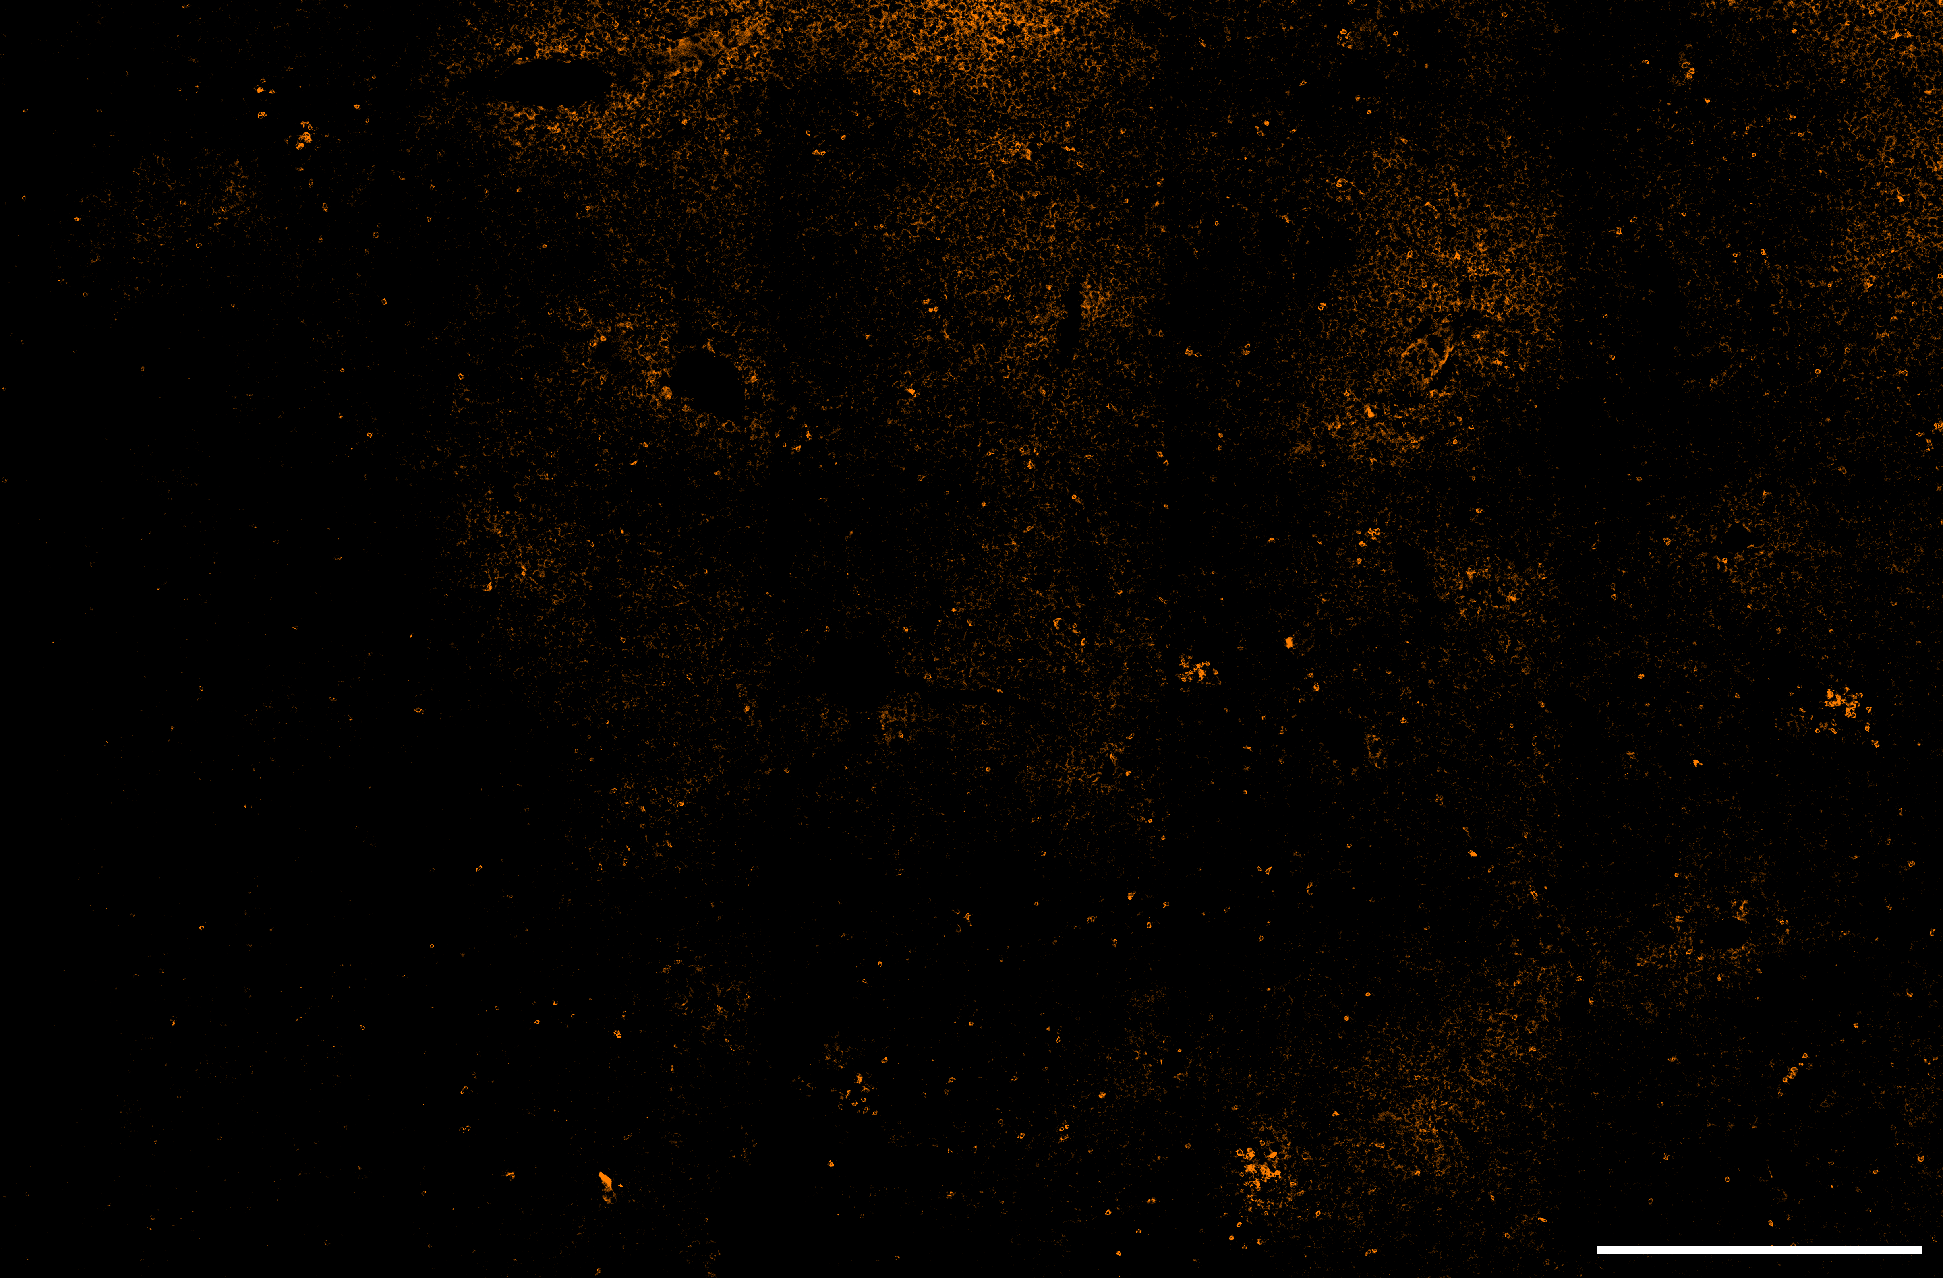
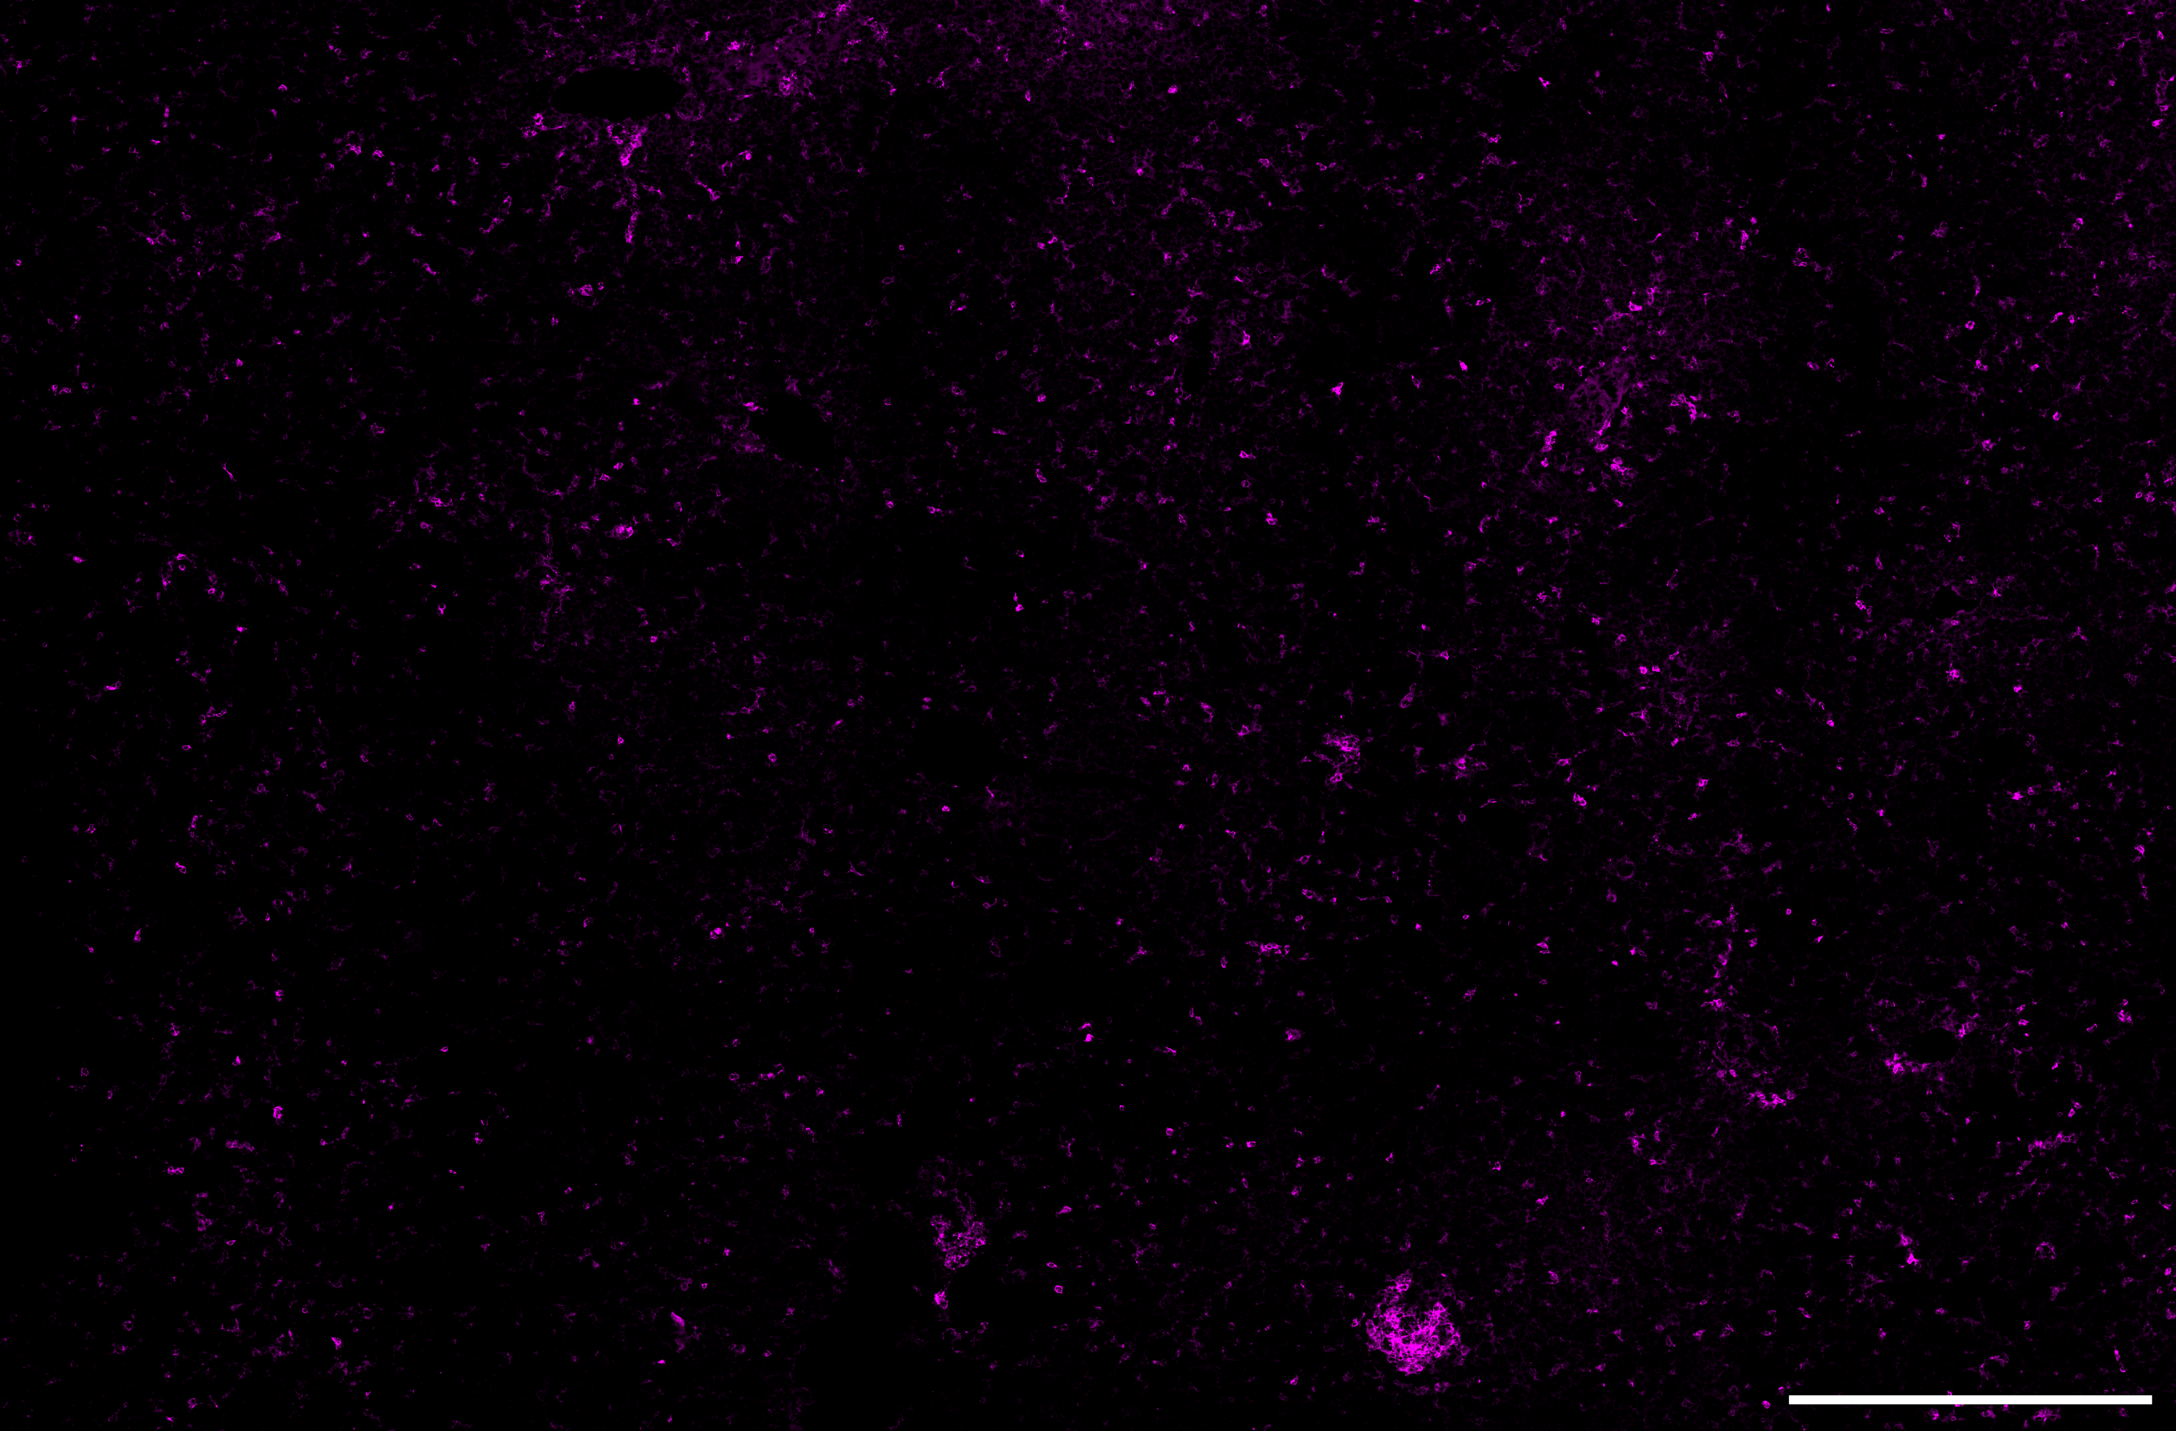
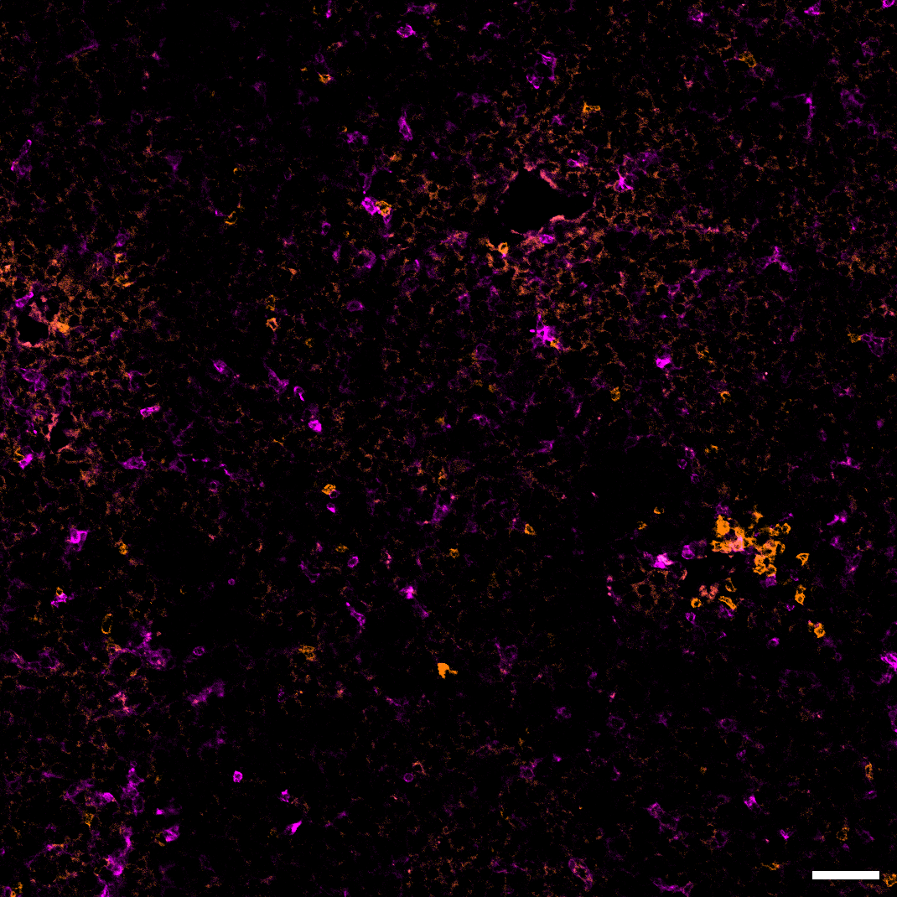
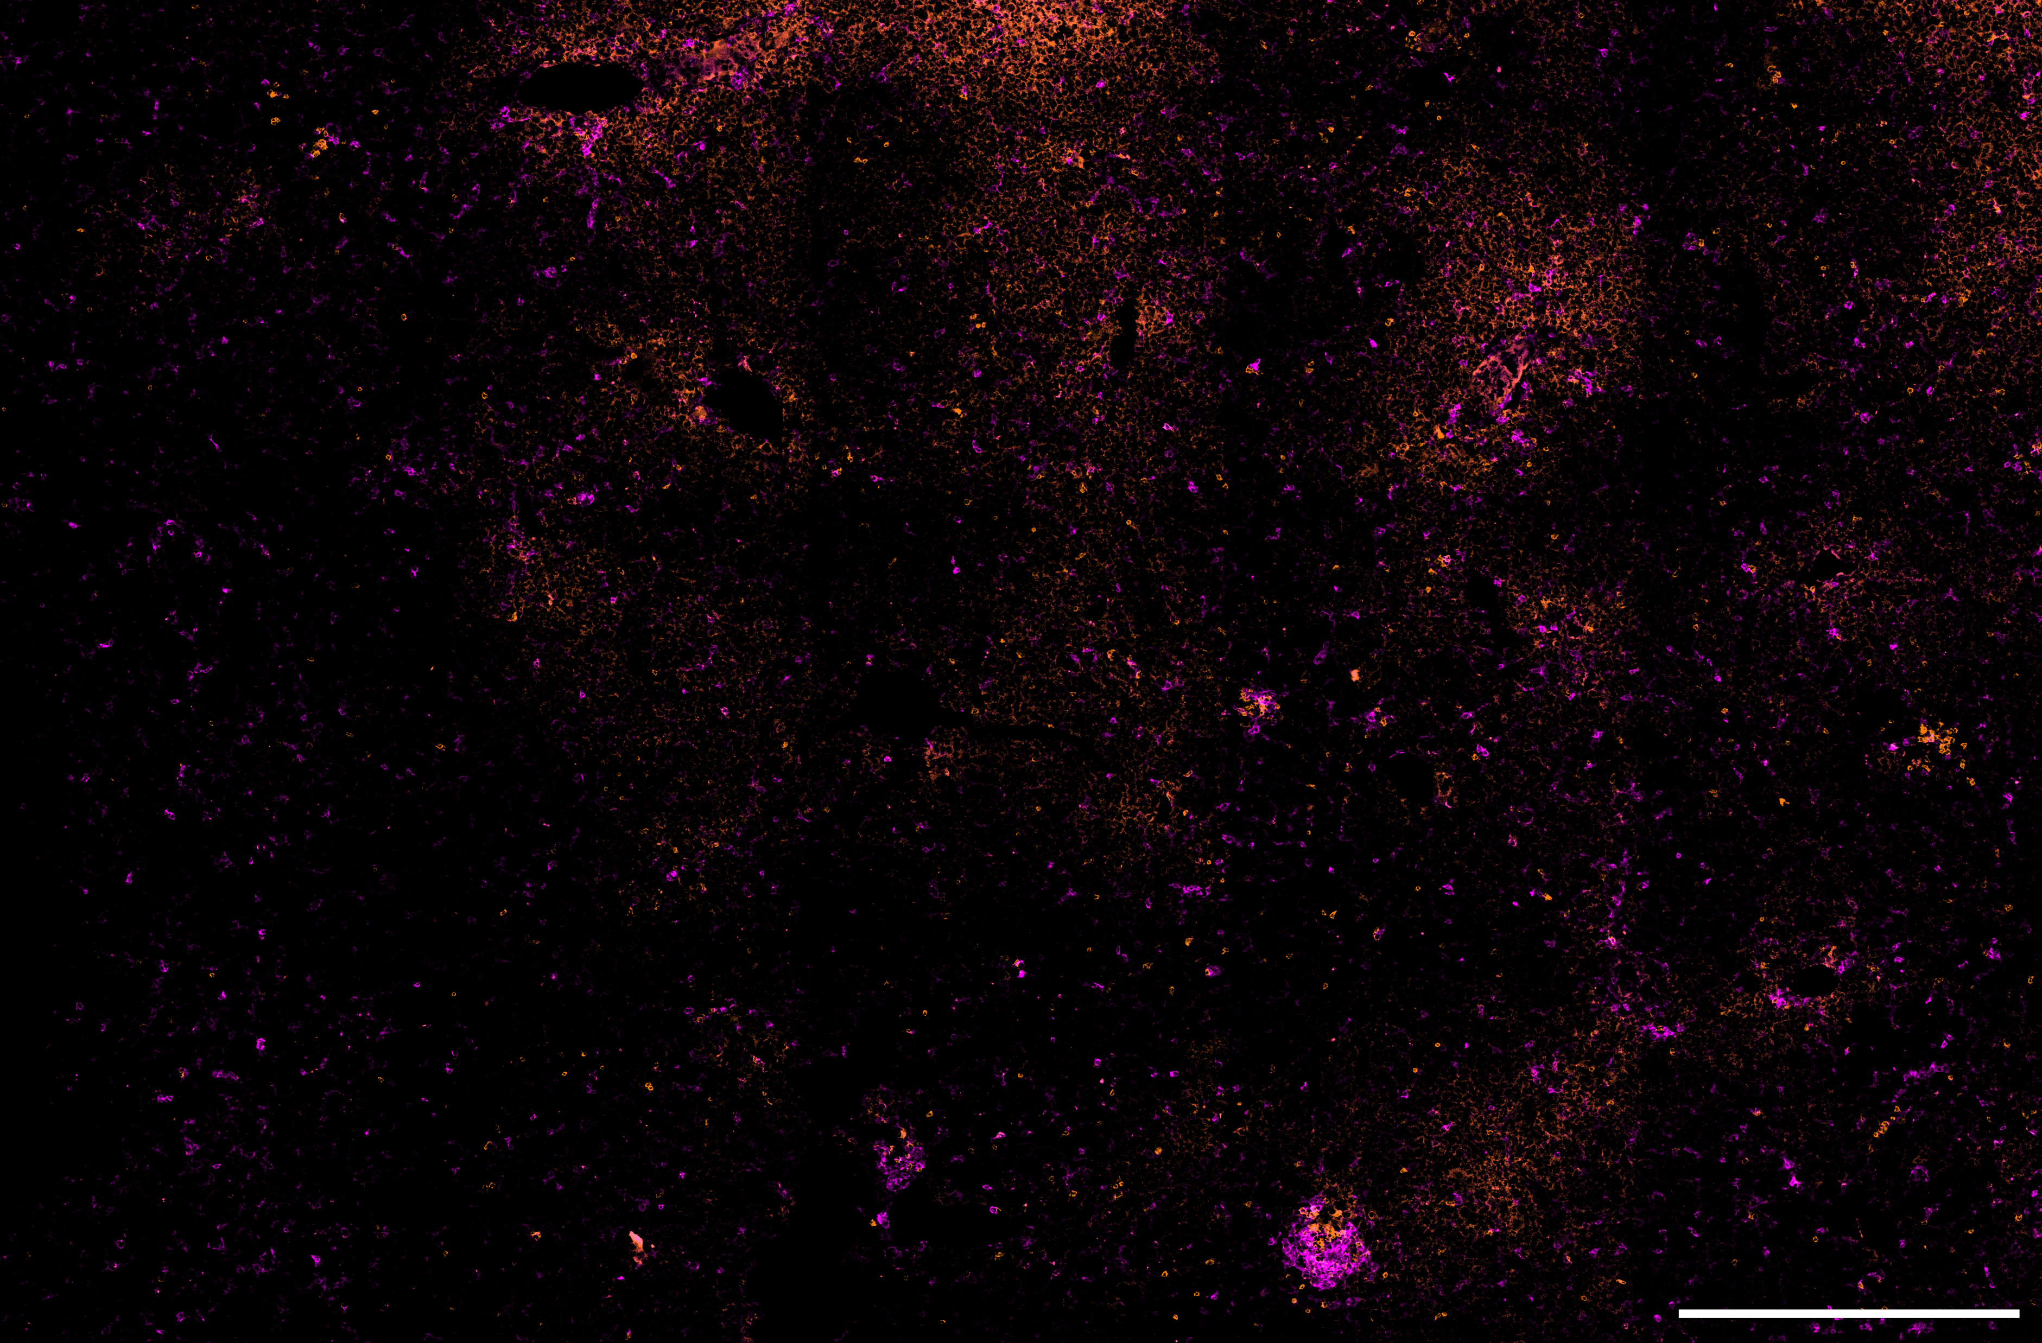
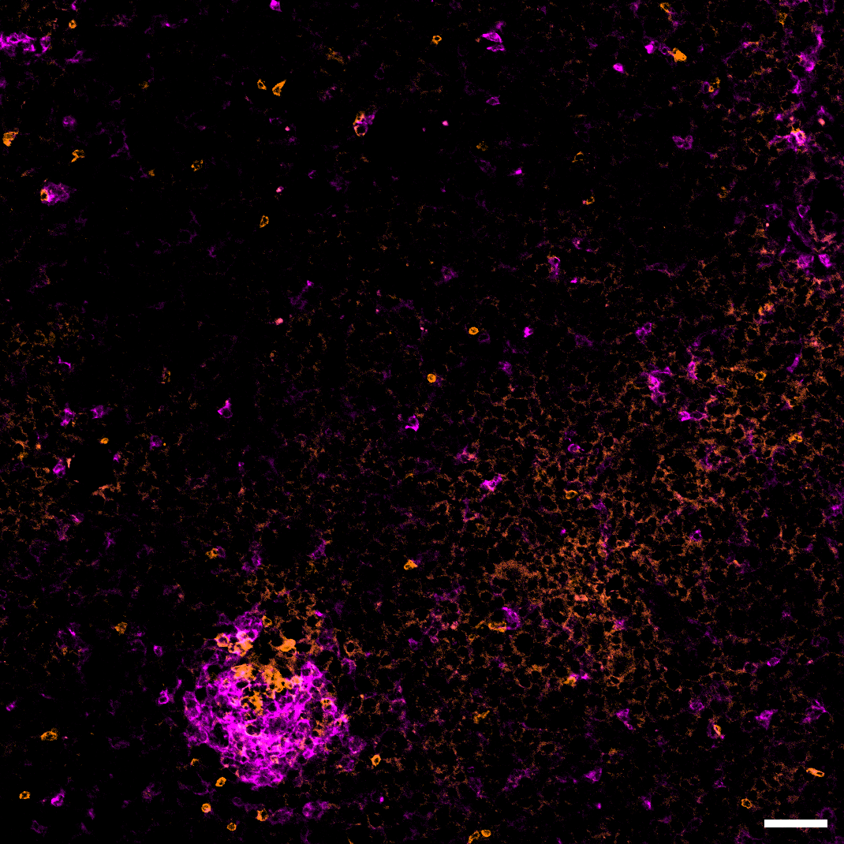
Notes:
[…]
DAPI CD4 CD11c
Slide ID: M3LP0345
x20 objective
scale bar = 500µm
roi = 50
Panel:
DAPI – AF488
CD4 – AF555
CD11c – AF647
DAPI
CD4
CD11c
ROI 1
Liver – BAAT KO (sgBAAT)
CD4 CD11c
CD4 CD11c
ROI 2
CD4 CD11c

Slide 11
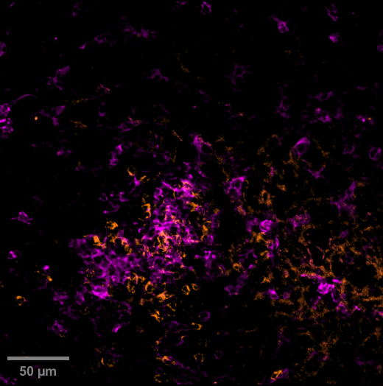
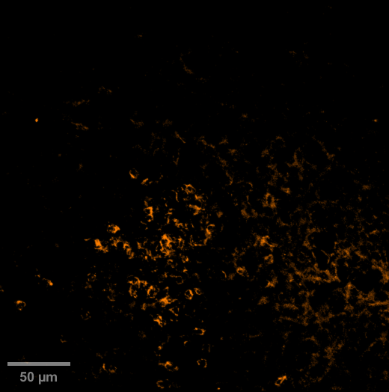
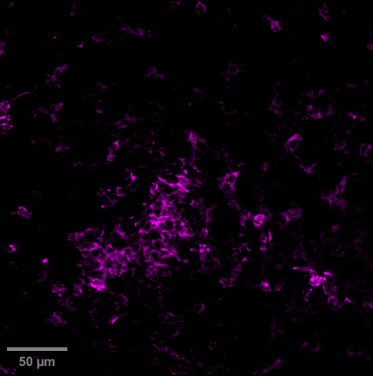
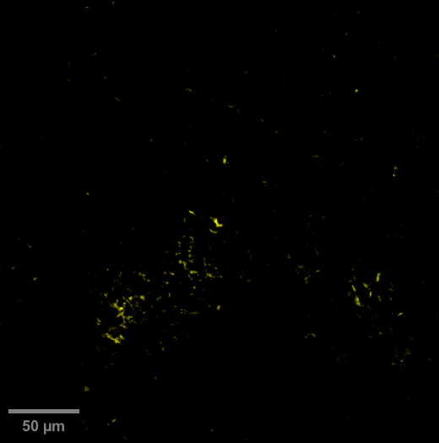
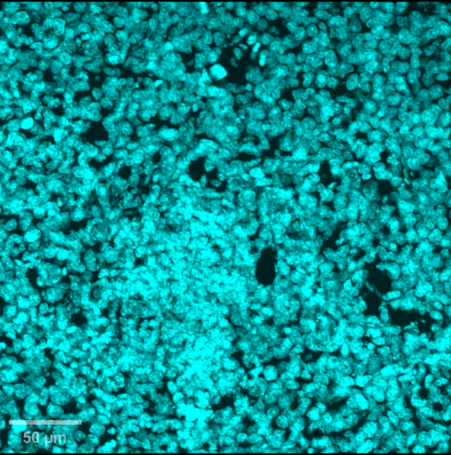
Slide ID: M3LP0345
x20 objective, zoom = 2.0, max Z proj.
Panel:
DAPI
Iba1 – AF488
CD4 – PE
CD11c – AF647
CD4/CD11c cluster
Notes:
[…]
Liver – BAAT KO (sgBAAT)
CD4 CD11c
CD4
CD11c
Iba1
DAPI

Slide 12
Notes:
[…]
SV40 Iba1 CD3ε LYVE-1
Slide ID: M3LP0429
x20 objective
scale bar = 500µm
roi = 50
Panel:
SV40 – AF488
Iba1 – AF555
CD3ε – AF647
LYVE-1 – AF750
Liver – BAAT KO (sgBAAT)

Slide 13
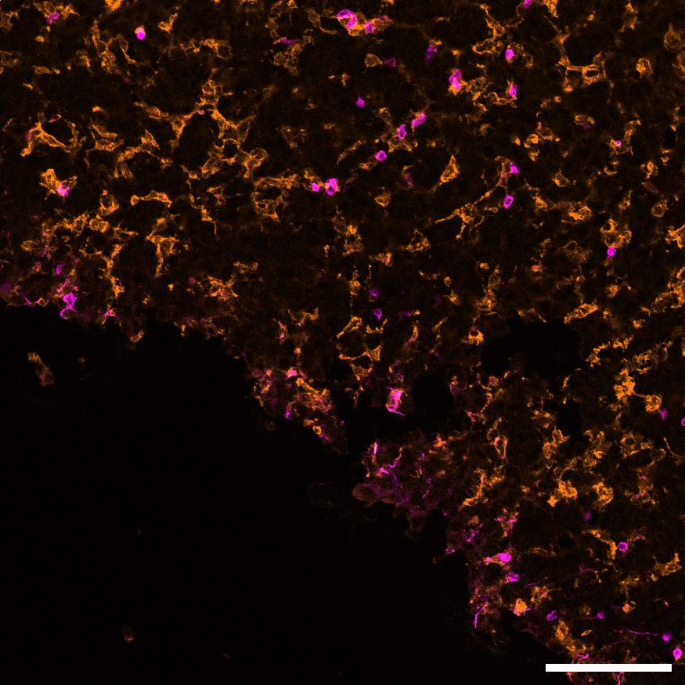
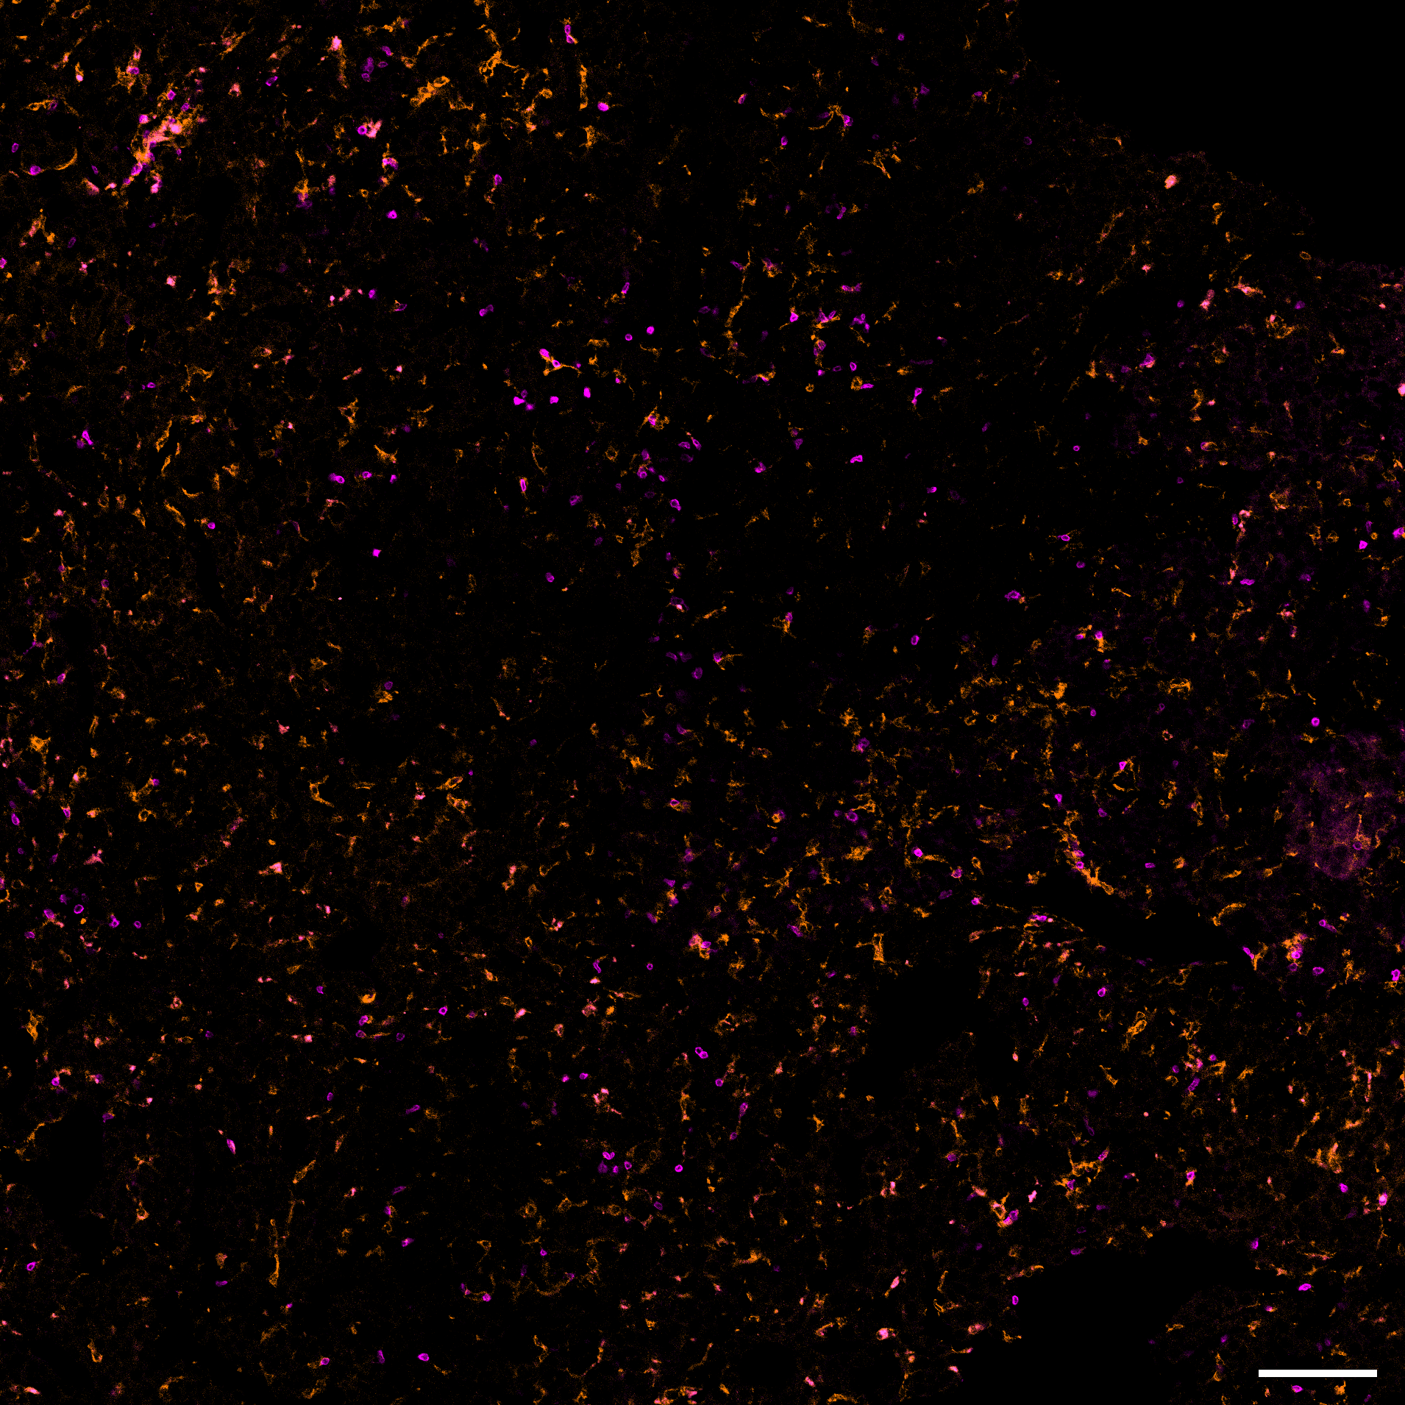
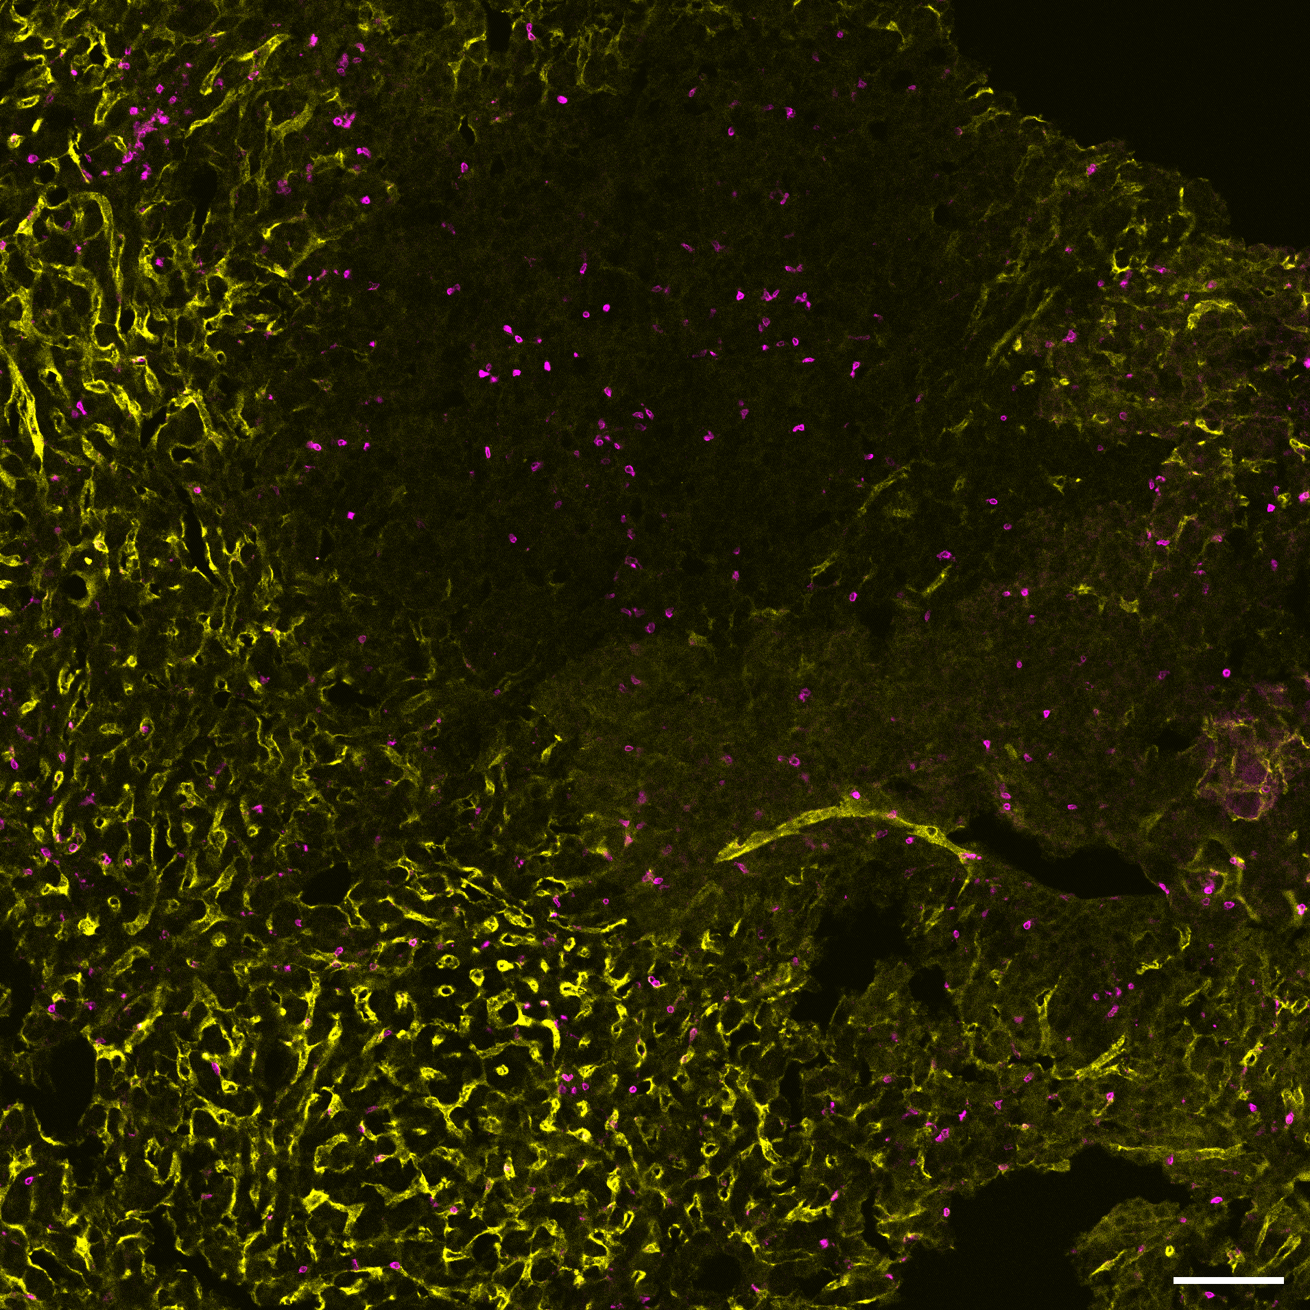
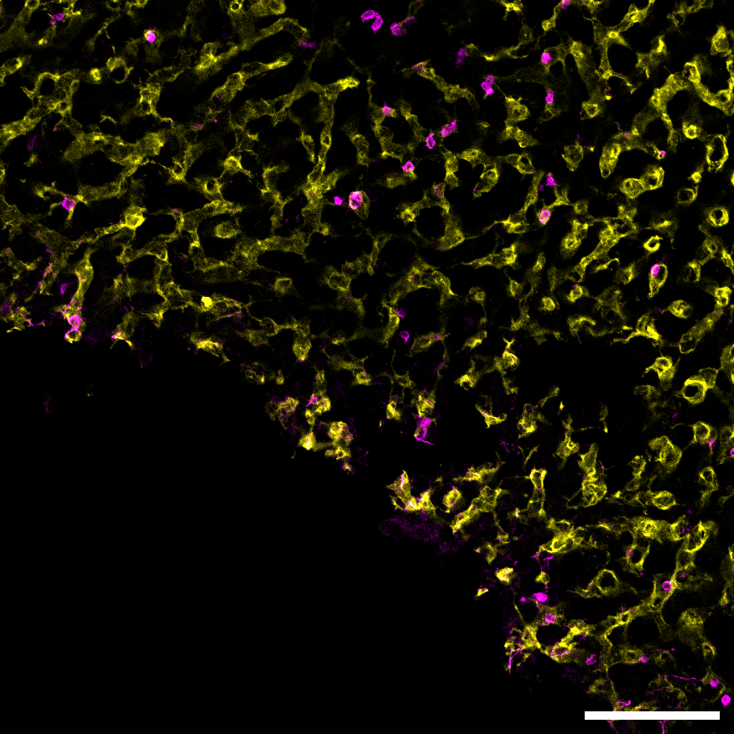
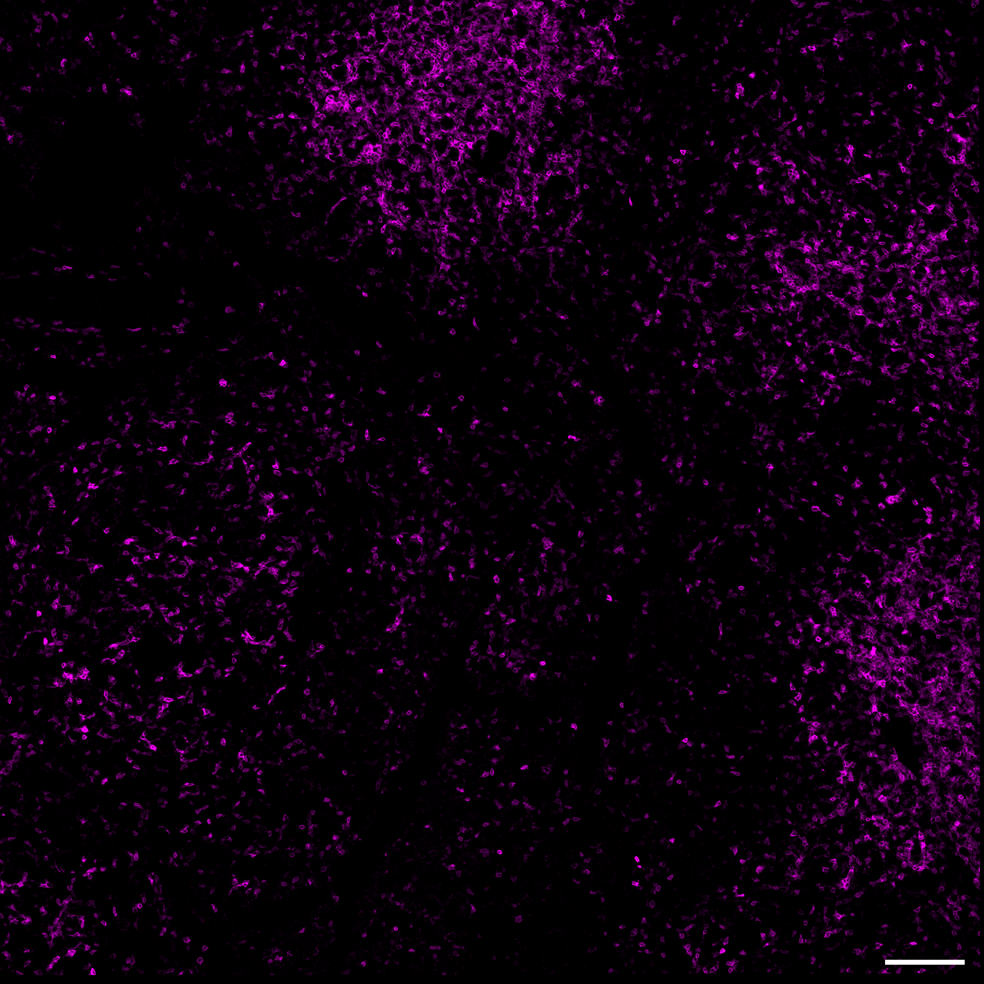
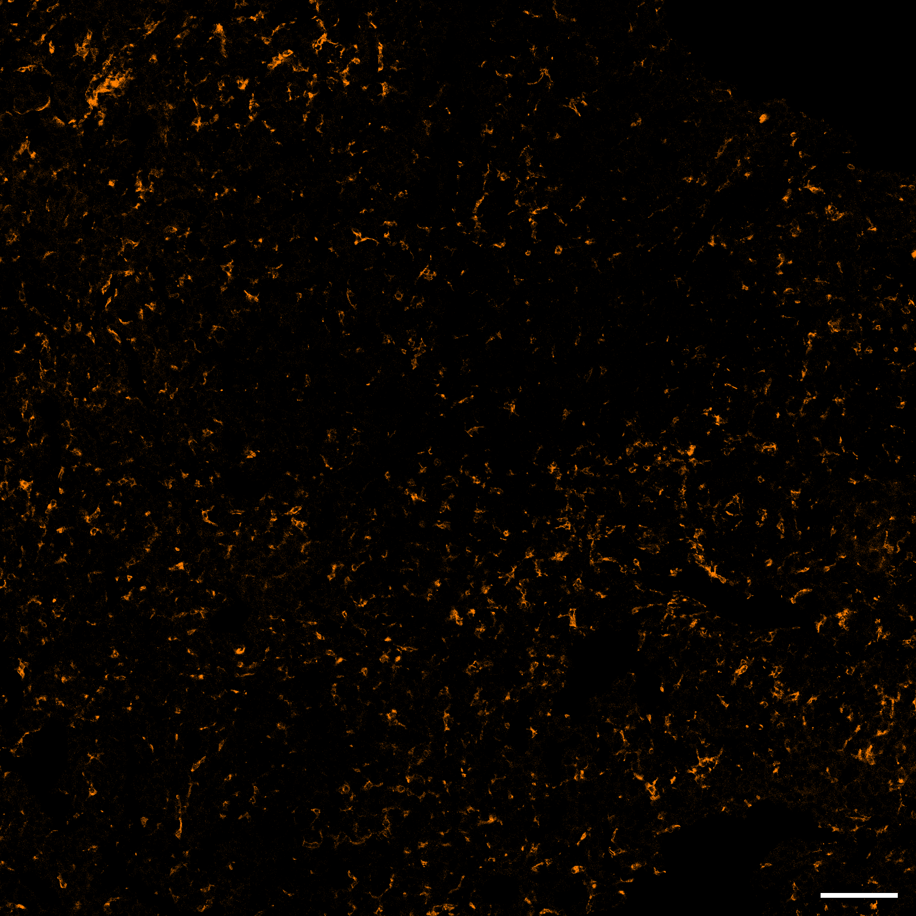
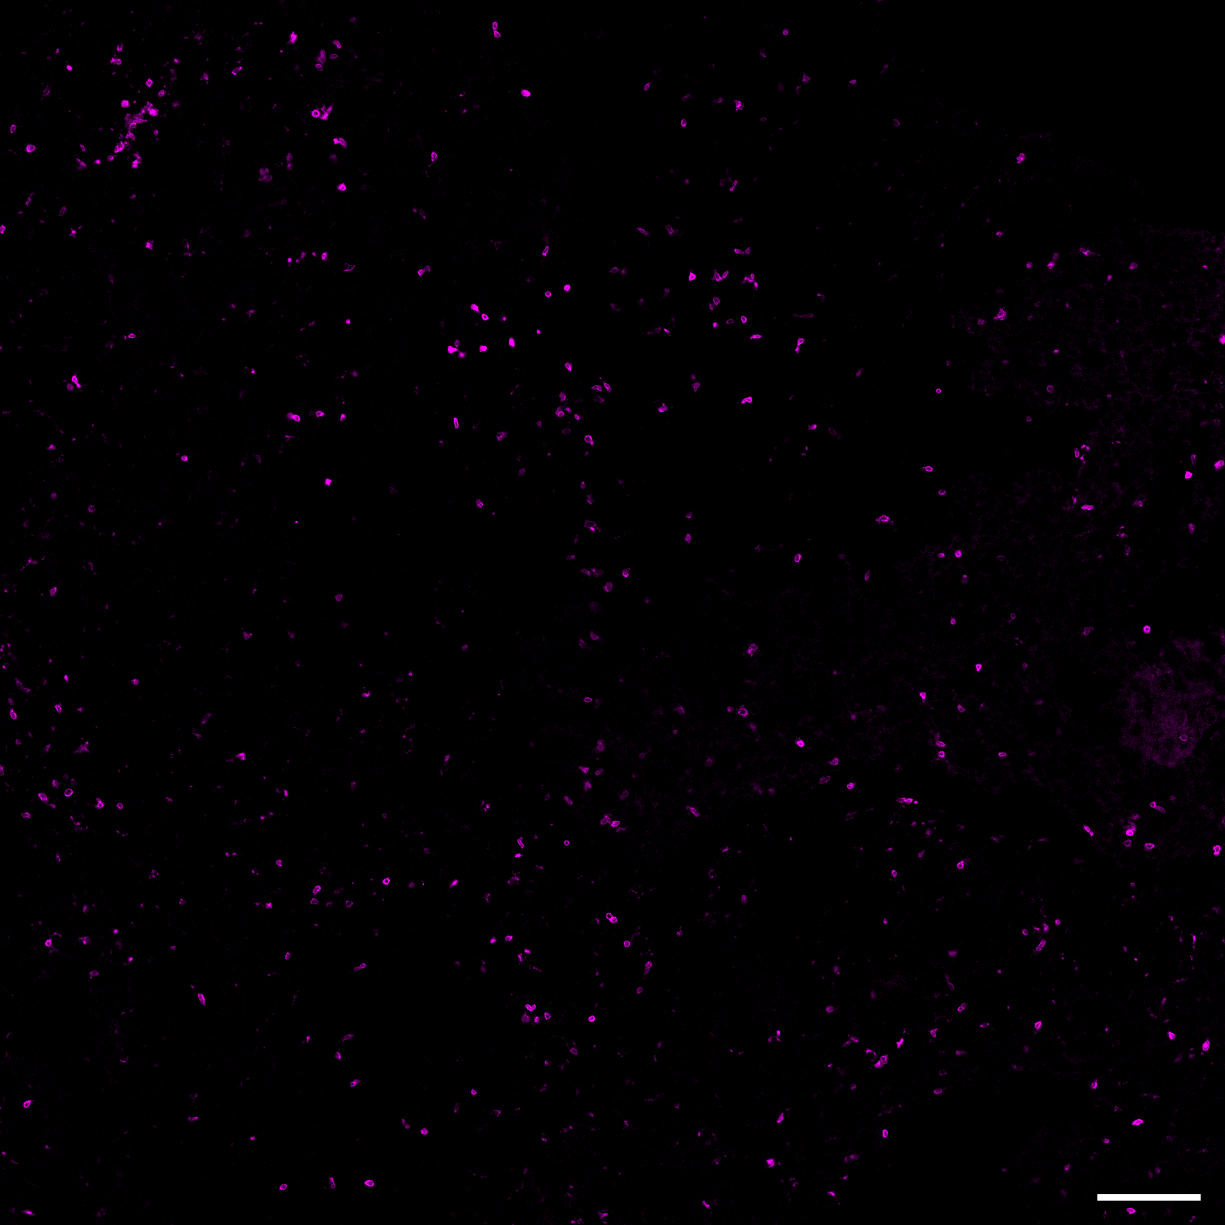
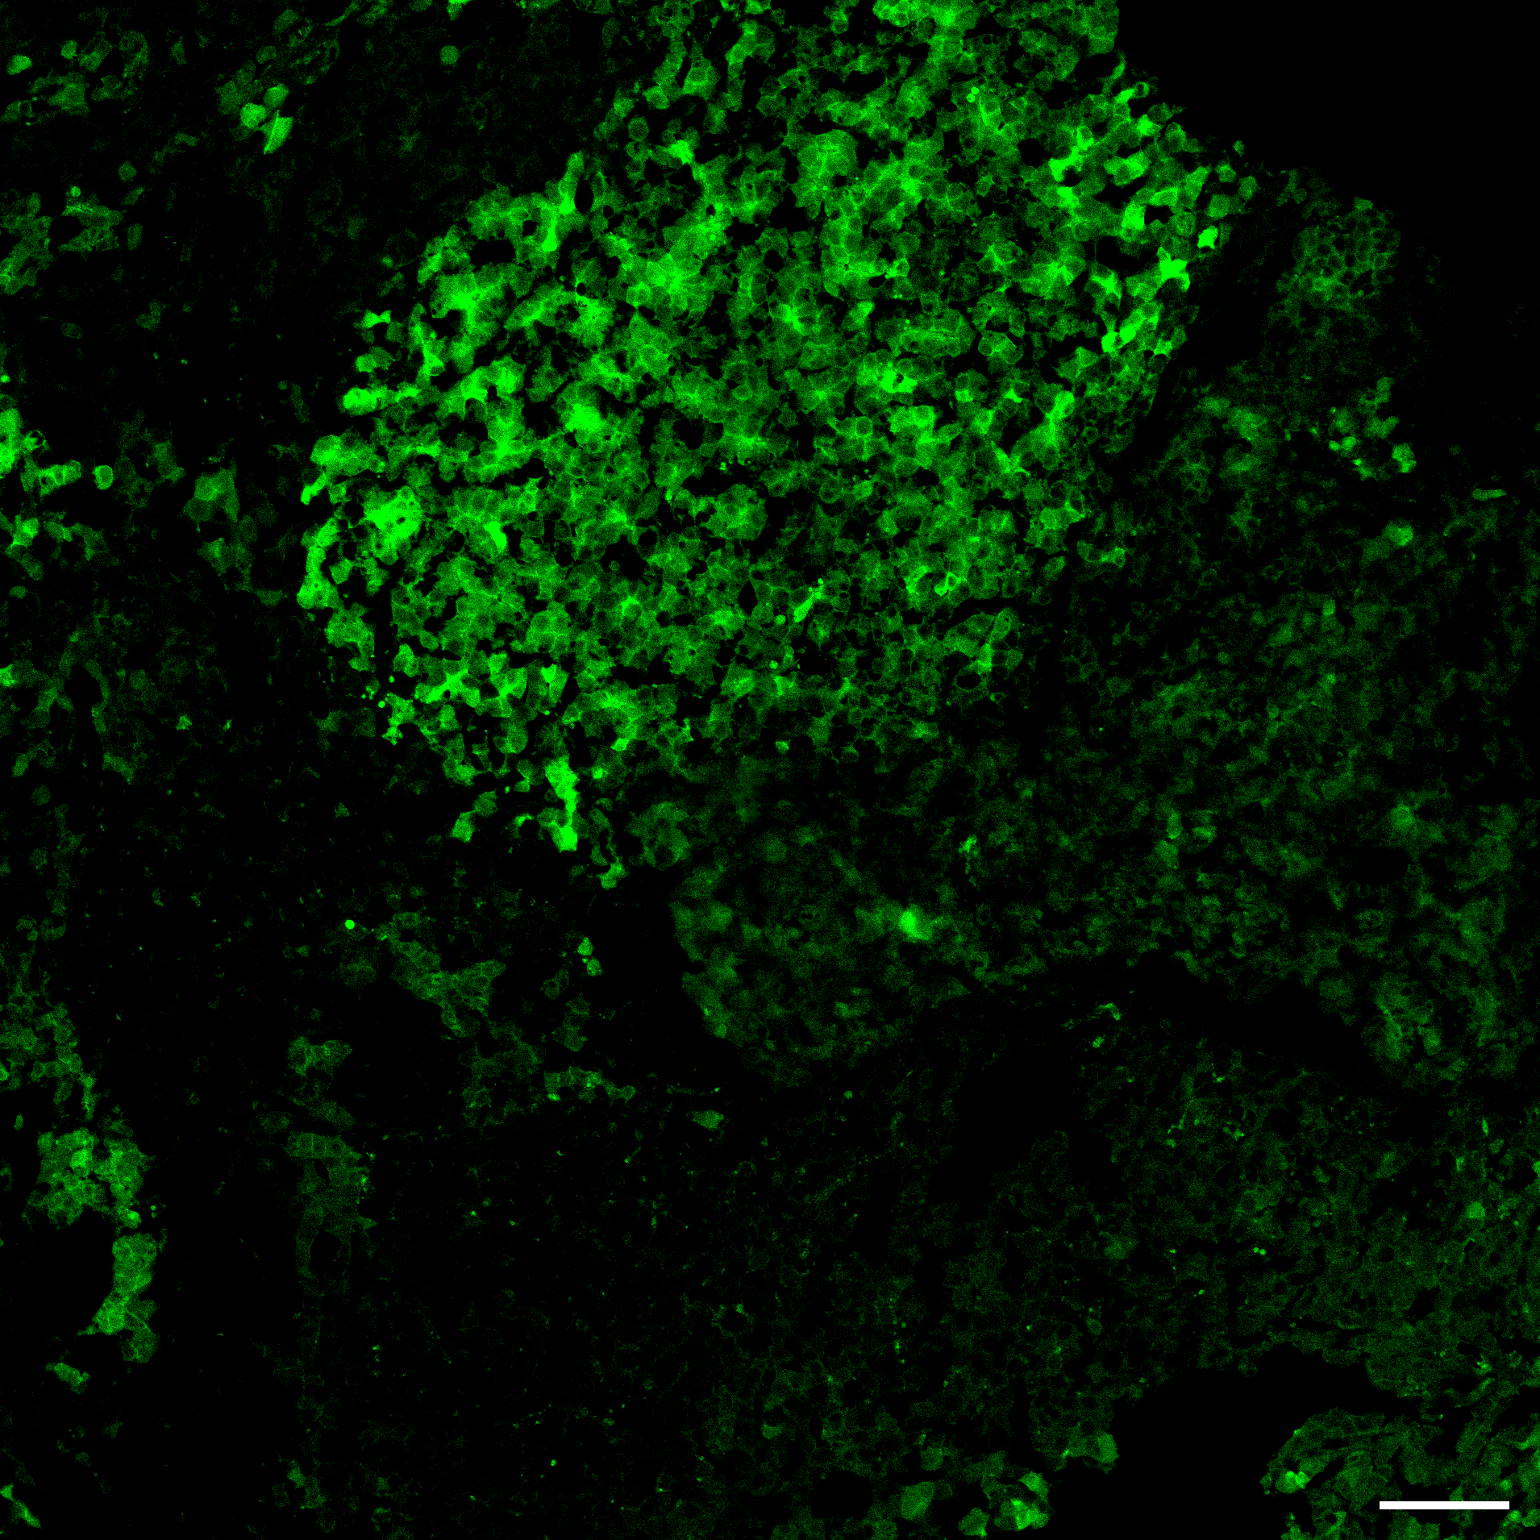
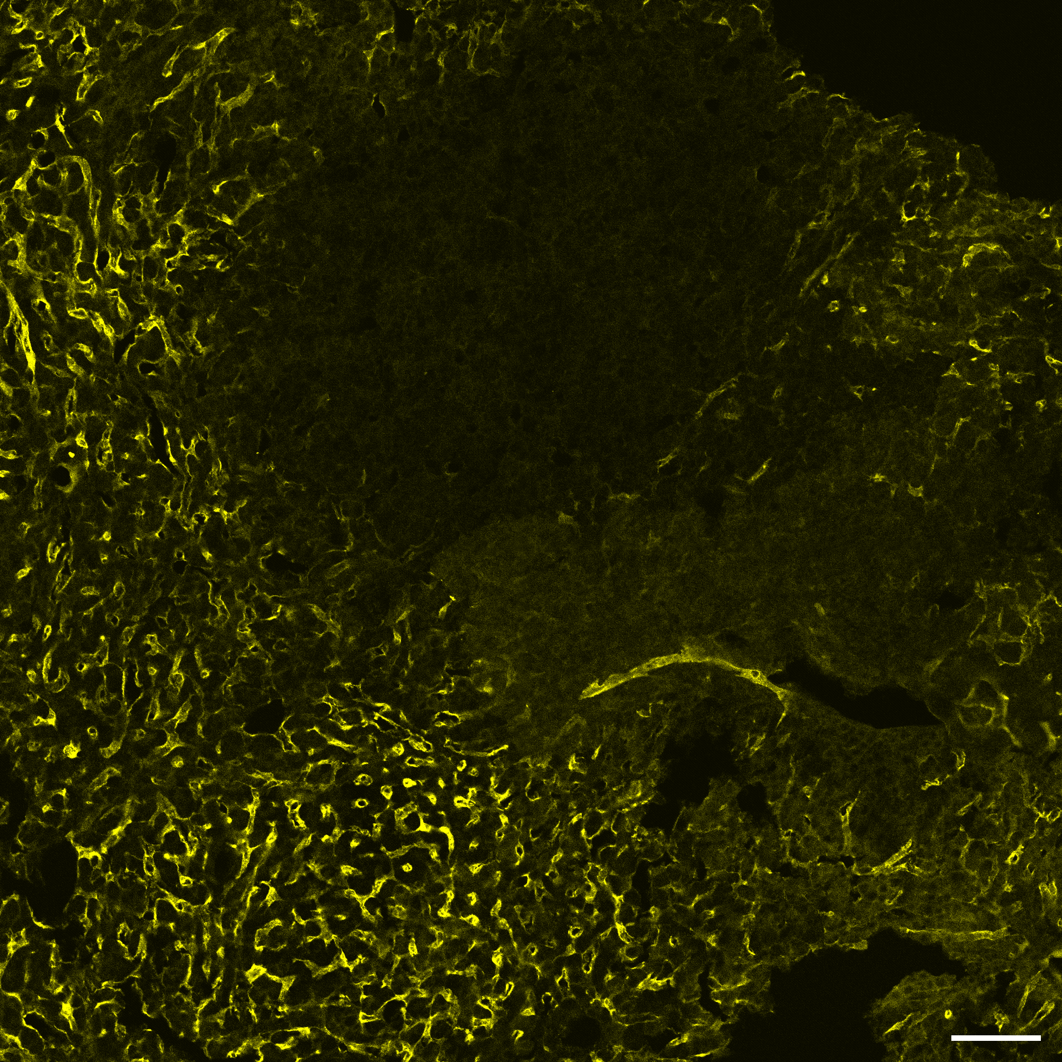
Notes:
[…]
Slide ID: M3LP0459-60
x20 objective
spleen bar = 100µm
SV40 Iba1 CD3ε LYVE-1
Liver – wk1 (sgScr)
Panel:
SV40 – AF488
Iba1 – AF555
CD3ε – AF647
LYVE-1 – AF750
Liver – BAAT KO (sgBAAT)
Spleen – naïve/healthy
for CD3 signal

Slide 14
Notes:
[…]
SV40 Iba1 CD3ε LYVE-1
Slide ID: M3LP0459
x20 objective
spleen bar = 100µm
Liver – wk1 (sgScr)
Panel:
SV40 – AF488
Iba1 – AF555
CD3ε – AF647
LYVE-1 – AF750
Spleen – naïve/healthy
Liver – BAAT KO (sgBAAT)
for CD3 signal

Slide 15
Notes:
[…]
SV40 Iba1 CD3ε LYVE-1
Slide ID: M3LP0459
x20 objective
spleen bar = 100µm
Liver – wk1 (sgScr)
Panel:
SV40 – AF488
Iba1 – AF555
CD3ε – AF647
LYVE-1 – AF750
Spleen – naïve/healthy
Liver – BAAT KO (sgBAAT)
for CD3 signal

Slide 16
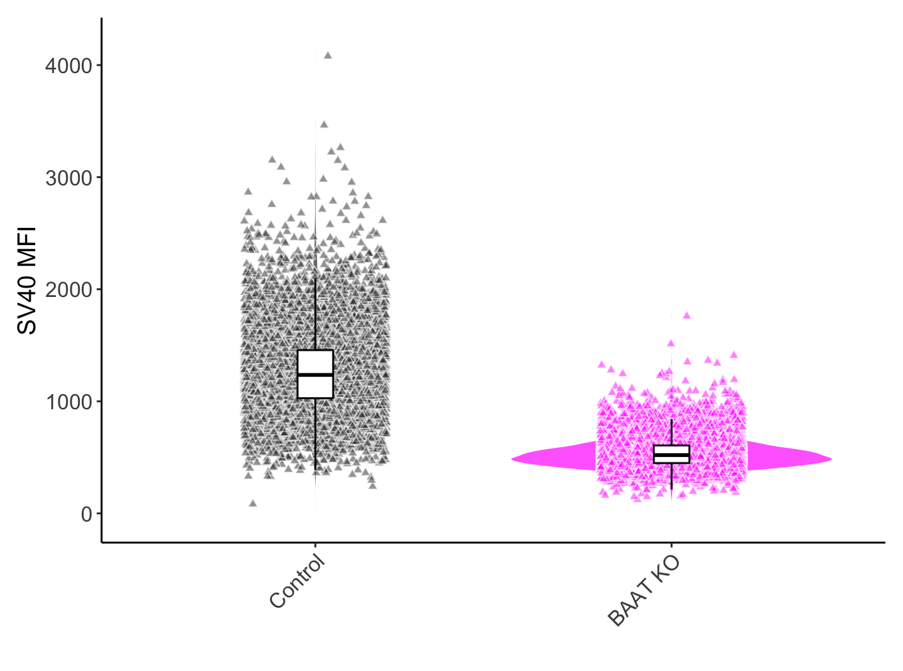
DAPI Iba1 CD4 CD11c
Slide ID: M3LP0345
x20 objective, zoom = 2.0
scale bar 50µm
FITC left open
Panel:
[…]
[…] – AF488
[…] – PE
[…] – AF647
Liver – BAAT KO (sgBAAT)
Notes:
[…]

Slide 17
Title
Notes:
Slide ID: M3LP0132

Slide 18
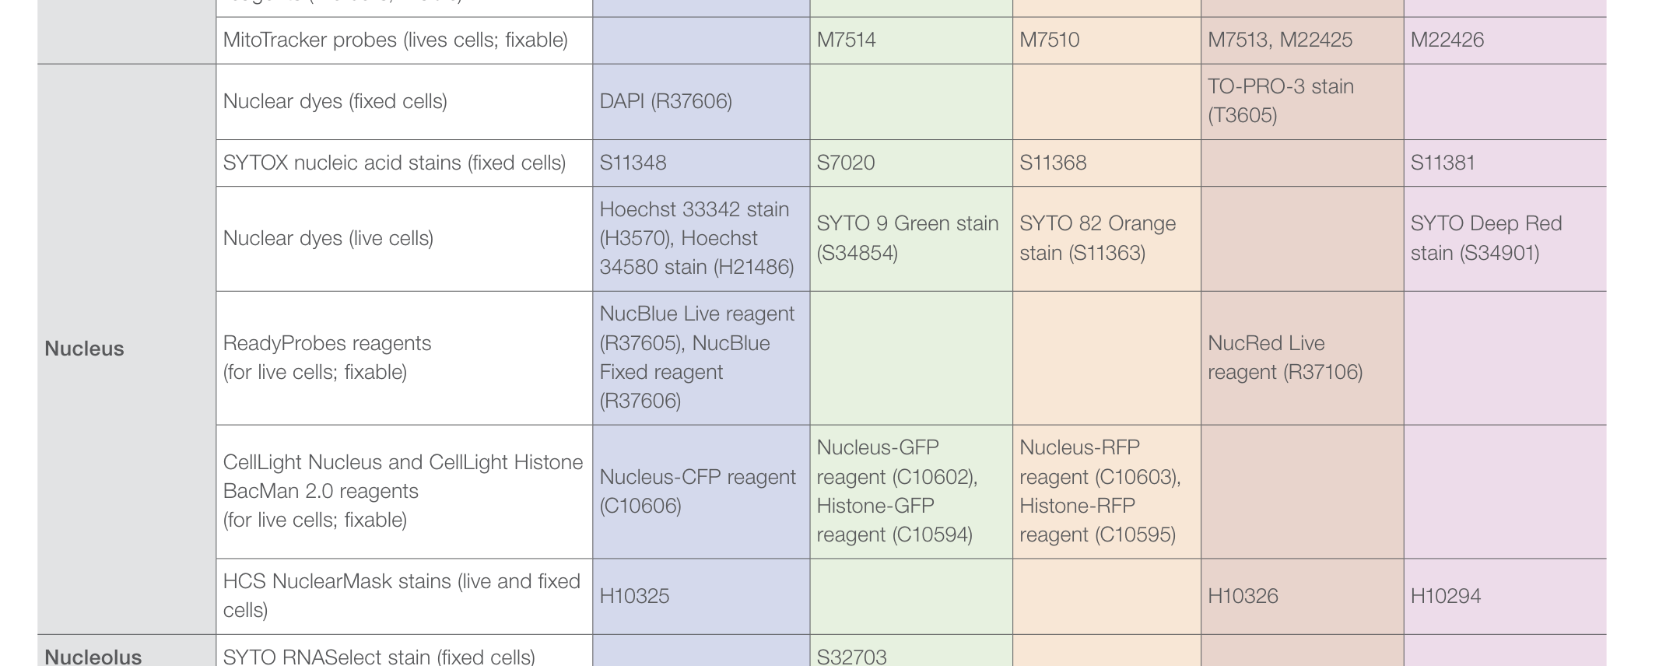
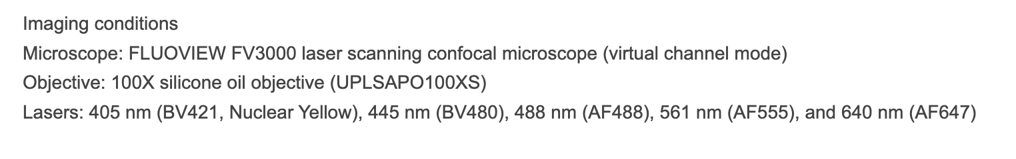
AXIO slides info.
No. | Slide ID | Project | Mouse info. | Panel | Tissue | Dates imaged | Notes
379 | M3LP0379 | VSK_GLUL | Control tumor liver | DAPI, BAAT-AF488, Thy1.1-PE, SV40-AF7647, LYVE-1-AF750 | Liver | FV3000 on 06/11/2024 | MyBioSource BAAT pAb (host = rabbit); [06/10/2024] blocked @ 12:00; primary @ 15:00; secondary @ 18:00; [06/11/2024] DAPI @ 10:00
380 | M3LP0380 | VSK_GLUL | BAAT KO liver 1 | DAPI, BAAT-AF488, Thy1.1-PE, SV40-AF7647, LYVE-1-AF750 | Liver | FV3000 on 06/11/2024 | MyBioSource BAAT pAb (host = rabbit); [06/10/2024] blocked @ 12:00; primary @ 15:00; secondary @ 18:00; [06/11/2024] DAPI @ 10:00
337 | M3LP0337 | VSK_GLUL | BAAT KO 1 | GS-AF405, Iba1-AF488, CD4-PE, CD11c-AF647 | Liver |  | 30µm sections + 10µL gel. alum.
339 | M3LP0339 | LGR lepto. | APP/PS1 inf. | CD8-BV421, Aβeta-AF488, Iba1-AF555, CD31-AF647 | Meninges
Notes:
Slide ID: M3LP0132

